Slide 1
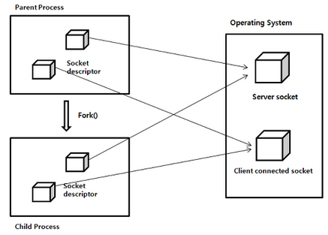
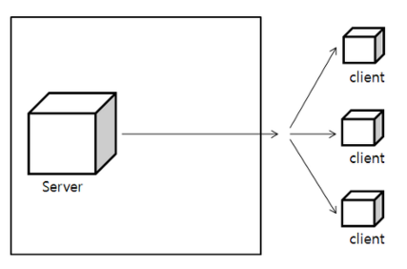
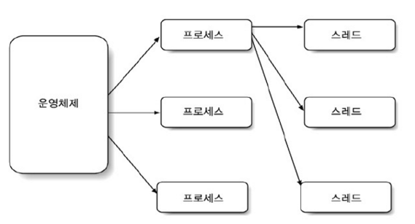
MultiProcess
Multiplexing
Multithreading
메모리 공간을 차지한 상태에서 실행중인 프로그램

Slide 2
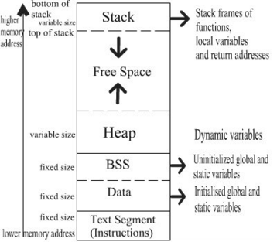
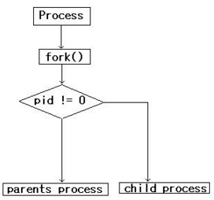
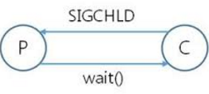
(1)
(2)

Slide 3
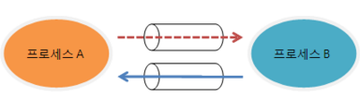


Slide 4
Select Rock Paper Scissors
Computers rock, paper, scissors selection
Computers rock, paper, scissors selection
The resulting decision
Game win-loss return
< Game A Algorithm >

Slide 5
Input your money
Presented two cards
Results cards presenting terminated after betting
Game win-loss return
Basic pay gambling gold
Start betting
< Game B Algorithm >

Slide 6
Process
Accept()
Fork()
Read(), write()
<<Parent>>
(Important services, connection management control)
<<Child>>
(Data communication with the client)
IPC

Slide 7
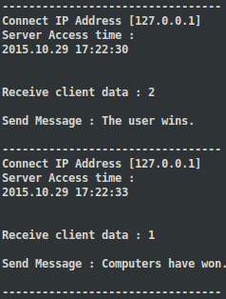
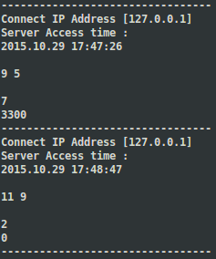
Game 1
Game 2

